Slide 1
CIRCULAR SEAM WELDING MACHINE
AND
LINEAR SEAM WELDING MACHINE

Slide 2
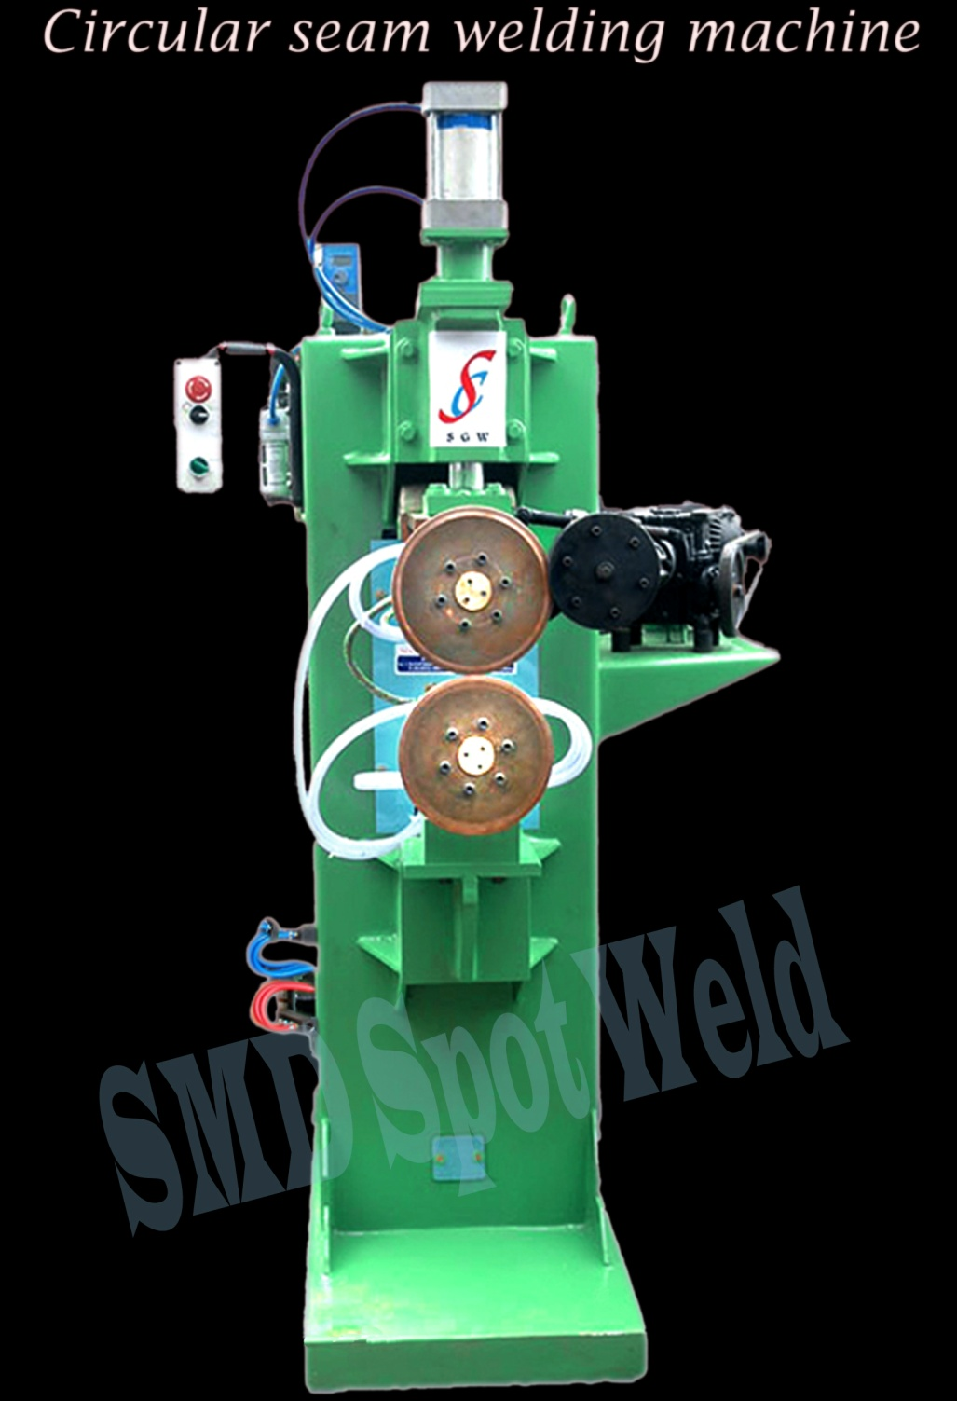
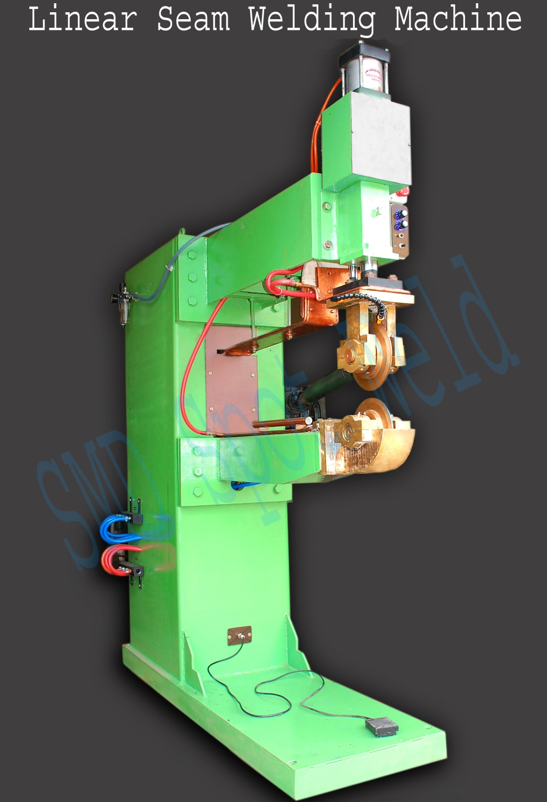

Slide 3
CIRCULAR AND LINEAR
Seam Welding Machine
Specification Model | i/v | Nominal power | Duty cycle | Rated frequency | Max short circular currental t d:400mm | Electrode wheel | Welding speed | Electrode stroke | Cooling water | Appx weight
SGW Seam | VAC | KVA | % | HZ | A | Mm | M / mm | Mm | L / mm | Kg
75 | 415 | 75 | 50 | 50 | 16000 | 200 / 10 | 0.8 – 3.0 | 100 | 40 | 1500
100 | 415 | 100 | 50 | 50 | 26000 | 200 / 12 | 0.8 – 3.0 | 100 | 40 | 1800
150 | 415 | 150 | 50 | 50 | 30000 | 200 / 12 | 0.8 – 3.0 | 100 | 40 | 2100

